Slide 1

Line detection through Hough transform
Department of Electronics and Communication Engineering
EC6421D Digital Image ProcessingTechniques
Mini Project
Naman Jain(M220327EC)
Shubham loni(M220305EC)

Slide 2
Contents
Introduction
Process of line detection
Canny edge detector
Flow chart of canny edge detector
Hough Concept
Flow chart of Hough transform
Output
Applications
Examples
References

Slide 3
INTRODUCTION
Can we fit lines, circles, ellipse or any other shape to link the edges?
“YES”.
The Hough transform is basically used for extracting feature from the image such as outlining , boundary , corners present in the image.
The key idea of Hough transform is that if two edges points lay on the same line, their corresponding cosine curves or lines will intersect each other on a specific parametric plane.

Slide 4
Process of Line Detection
Input image
Edge detection
Hough transform
Output Image

Slide 5
Canny Edge Detector
The Canny edge detector is an edge detection method that has multistage algorithm to detect the wide range of edges in an image
It was developed by John F. Canny in 1986.
Canny edge detection is a technique to extract useful structural information from different vision objects and dramatically reduce the amount of data to be processed.
It has been widely applied in various computer visionsystems.

Slide 6
Flow chart of canny edge detector
Noise Reduction
Edge detection
Non – maximum suppression
Double Thresholding
Hysteresis Edge tracking
Using Gaussian operator
Using Sobel operator

Slide 7
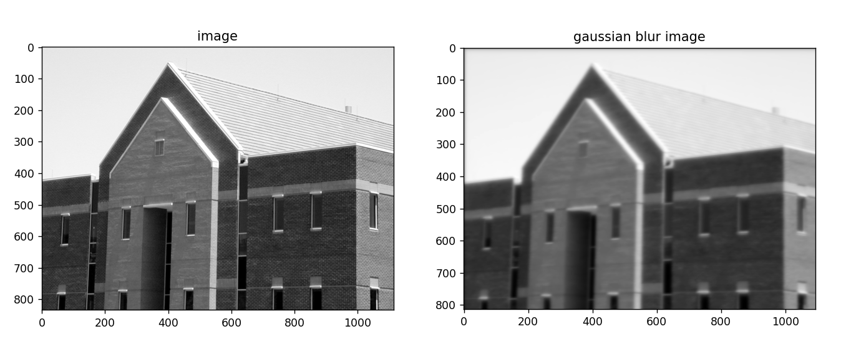
Noise Reduction :
It is basically a smoothing technique.
In an image noise consist of sharp transition in intensity
To eliminate those noise spatial filters are used such as box filter , weighted averages and Gaussian filter.
Gaussian smoothing is widely used.

Slide 8
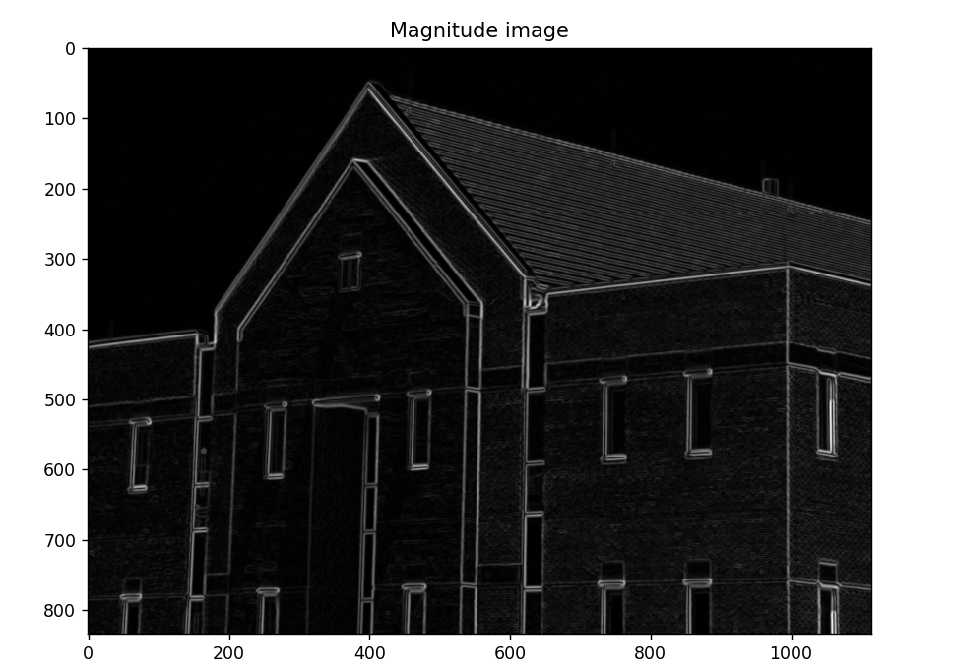
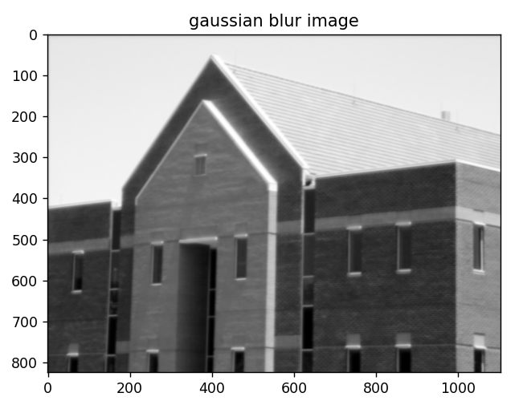
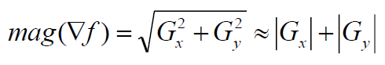
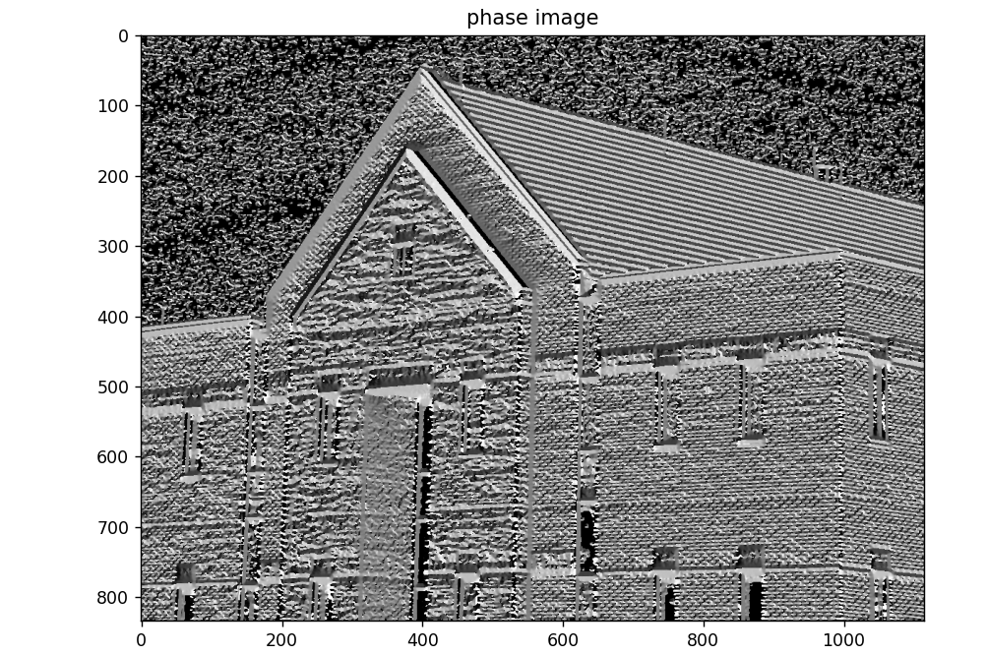
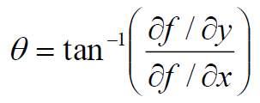
Edge detection:
The Gradient operator is used .
Mag(img)
Phase (img)

Slide 9
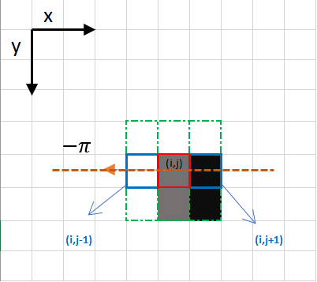
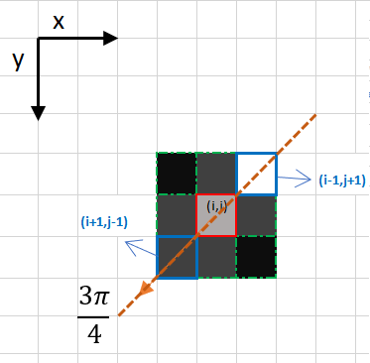
Non-maximum suppression:
Original phase is Quantize into one of the four different phases.
Go in the direction specified by the gradient ,then check the neighbouring pixel .
If lower then the centre pixel then treated as edge.

Slide 10
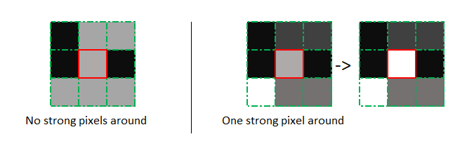
Double Thresholding and Hysteresis:
Here we are taking Double Thresholding instead of standard way of threshold.
The double threshold step aims at identifying 3 kind of pixels :strong ,weak and non relevant .
Strong:- pixels having intensities so high that they are surely contribute to final edge.
Weak:- pixels having intensities so low , that is not enough to be consider as strong ones but yet not small enough to be consider non-relevant to be an edge.
Other pixels are consider to be non-relevant to the edge.

Slide 11
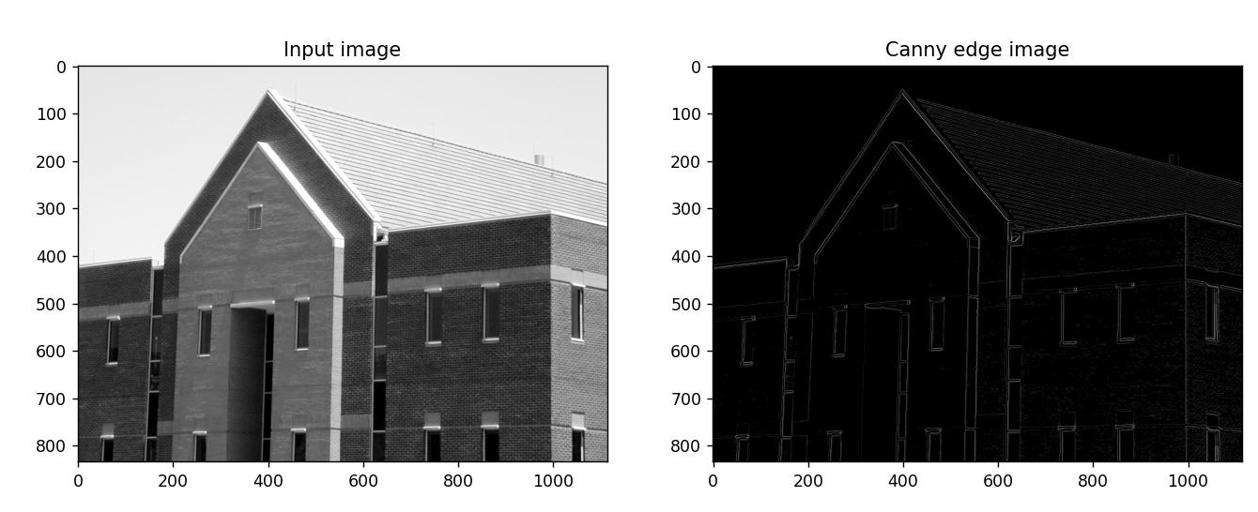
Canny Edge Image

Slide 12
Hough Transform
Elegant method for direct object recognition
Edges need not be connected
Complete object need not be visible
Key Idea: Edges VOTE for the possible model

Slide 13
Flow chart of Hough transform:
Input Edge image
Detection of Line
Mapping edge points to parametric space
Creating ACUMULATOR
Find the point with maximum voting

Slide 14
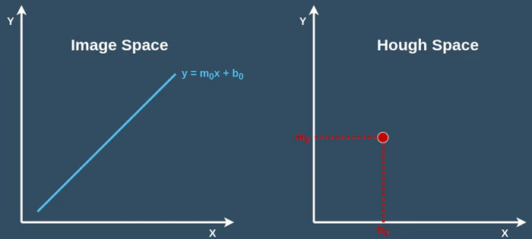
Hough Transform: Concept

Slide 15
Line Grouping Problem

Slide 16
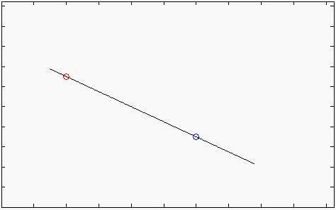

The Straight Line
For each point (x , y) in the line the following equation applies:
Therefore:
(x₁,y₁)
$$y=m⋅x+c$$ $$y_{1}=m⋅x_{1}+c \\ y_{2}=m⋅x_{2}+c$$
(x₂,y₂)

Slide 17
Multiple Lines over a single point
y=m₂x+b₂
Each pair (m , b) defines a distinct straight line containing the point (x,y)
y=m₁x+b₁
y=m₄x+b₄
(x,y)
y=m₃x+b₃

Slide 18
The Parameter Plane
Each point in the (x,y) space(image plane) is mapped to a straight line in the (m ,b) space (parameter plane).
A straight line in the (x,y) space (image plane) is mapped to the intersection point of the lines corresponding to its points, in the (m.b) space (parameter plane).
b =-mx₁+y₁
(x₁,y₁)
(x₂,y₂)
(x₃,y₃)
b =-mx₃+y₃
b =-mx₂+y₂

Slide 19
The Accumulator Concept
_{b}
The (m.b) space (parameter plane) is subdivided in cells.
Each pixel (x,y) in the original image vote in the (m, b) space for each line passing through it.
The votes are summed in an Accumulator
b₁
N
Corresponds to a straight line
y=m₁x+b₁
of N pixels length
m_{min}
m₁
m
m_{max}

Slide 20
The Motivation for Polar Coordinates
Vertical lines cannot be mapped to the (m,b) space, since:
Vertical lines can be described using polar coordinates :
x = r
xcos0 + ysin0 = r
r

Slide 21
Using Polar Coordinates
For each point (x,y) in the line the following equation applies:
In particular:
(x₁,y₁)
(x₂,y₂)
r
θ

Slide 22
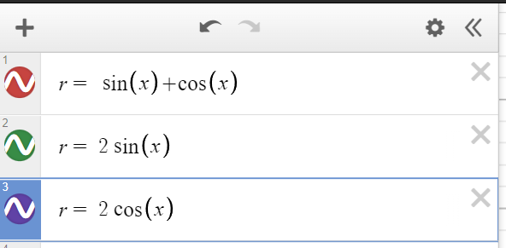
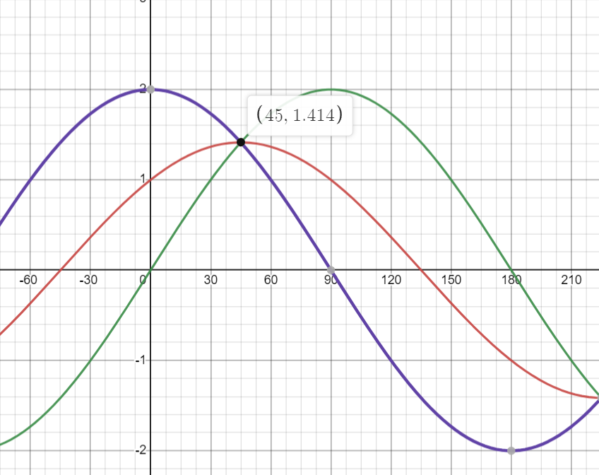
r = x · cos θ + y · sin θ
For given point (0,2) , (2,0), (1,1)

Slide 23
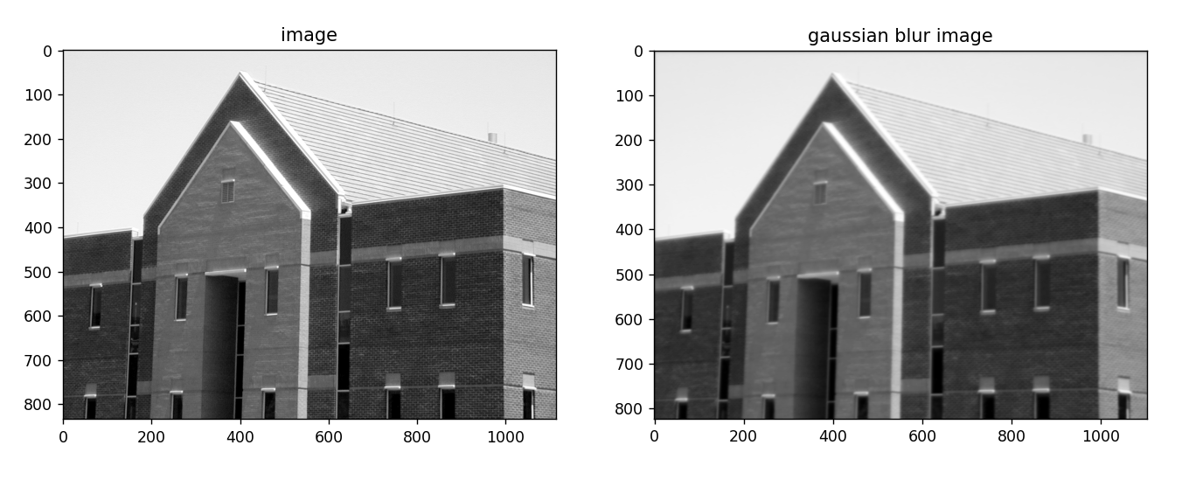
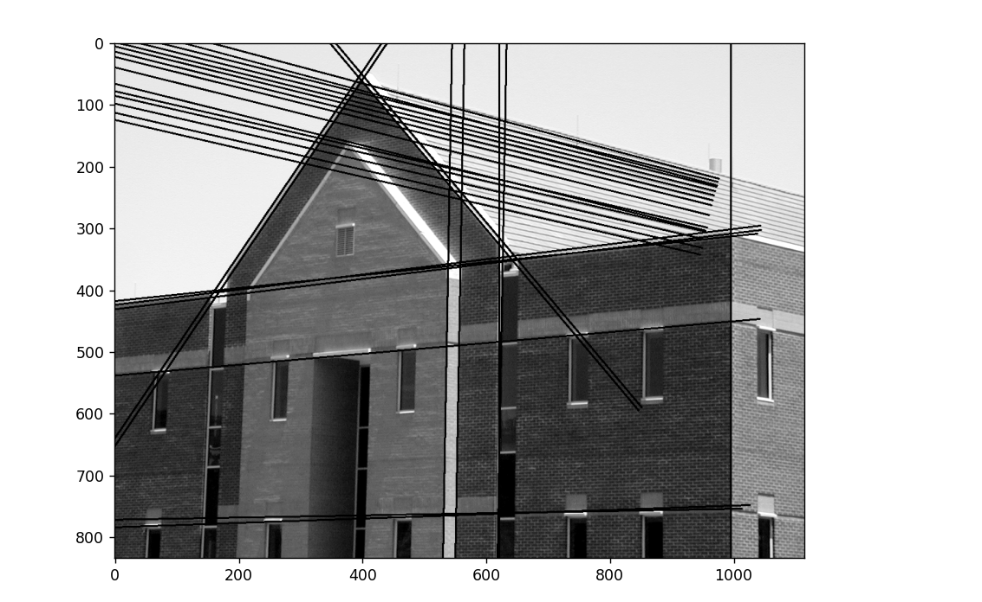
Output
Input Image
Output Image

Slide 24
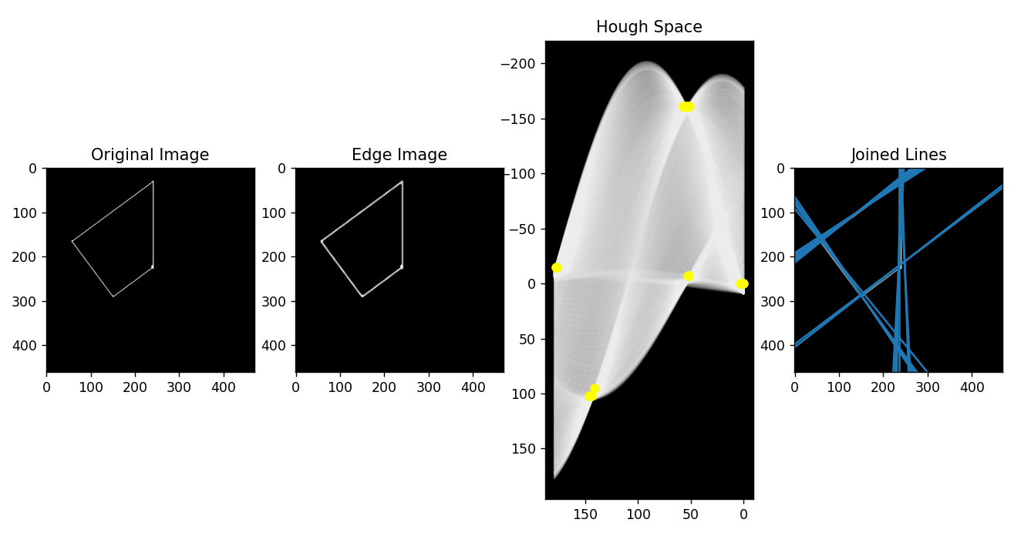
Examples

Slide 25
Applications
It is widely used in feature extraction (shapes of the objects).
Another big advantage is used for the building-edge extraction.
It can extract the lines even through the noisy data.
By the Hough transform, we can detect the missing lines which are broken while detecting edge image.
We can use it in lane detection of the road.

Slide 26
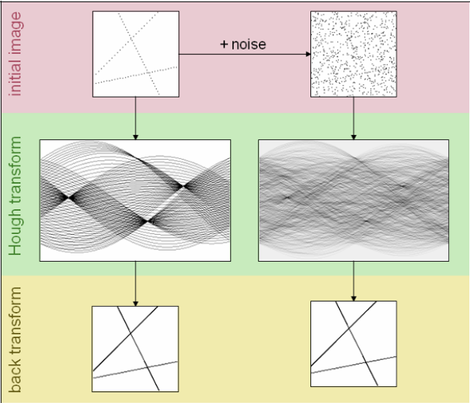
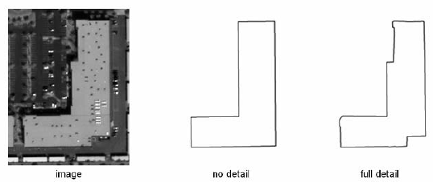

Slide 27
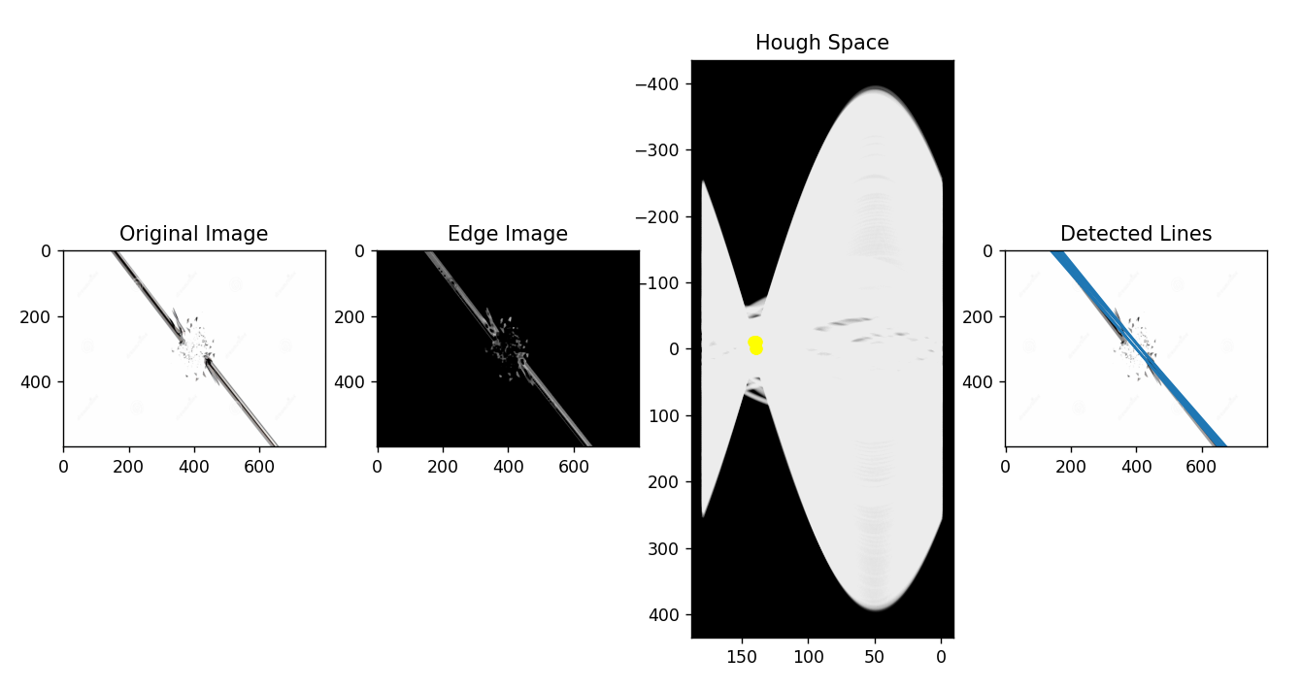

Slide 28
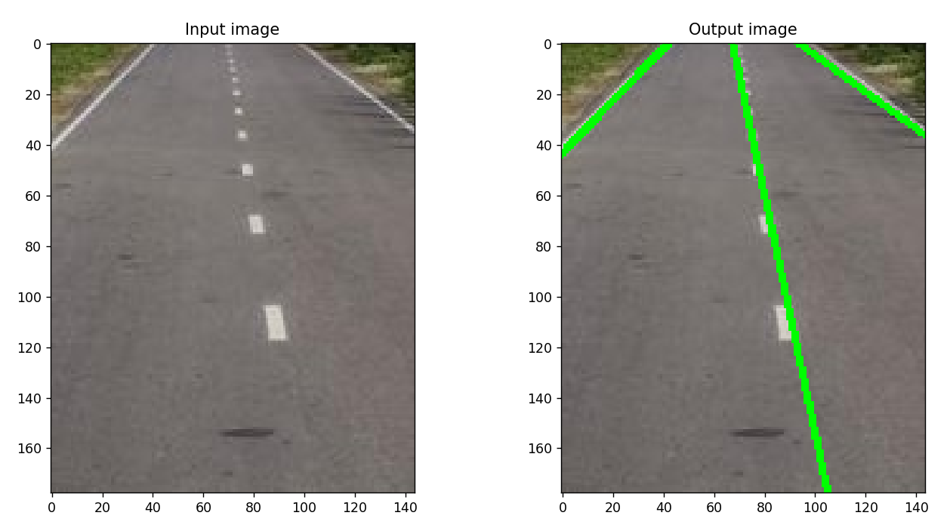
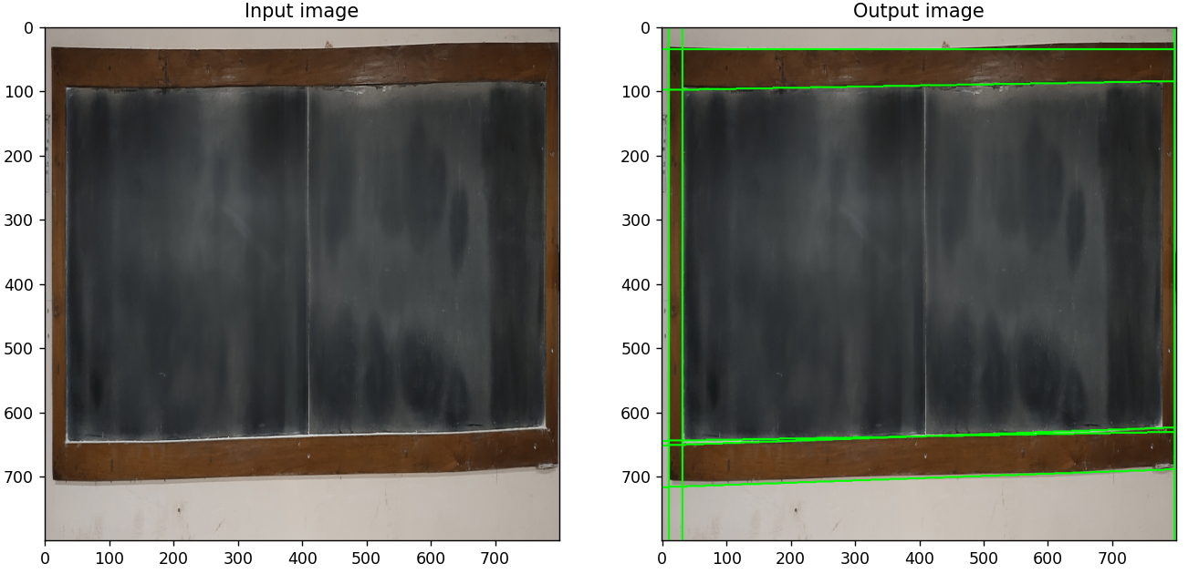

Slide 29
REFRENCE
Names: Gonzalez, Rafael C., author. | Woods, Richard E. (Richard Eugene), author
Wikipedia, Internet search
https://ieeexplore.ieee.org/document/6949962 DOI :- 10.1109/ICCSP.2014.6949962
https://ieeexplore.ieee.org/document/9422200 DOI :- 10.1109/TPAMI.2021.3077129

Slide 30
Thank You

